Slide 2
Minor Project- 1
on
Comparative Analysis of shortest path algorithms on the basis of graphical plots
Under the Guidance of:
Ms. Kalpana Rangraa
Presented by:
Siddhi Gupta
R100218061
500067967
Yogesh
R100218069
500069549
Tushar Goyal
R100218072
500068373
Bhavuk Baluja
R100218073
500070089

Slide 3
Problem Statement
There are several projects for finding the shortest path but they all give the output in written form, which is difficult to understand and it takes more time to understand the shortest path.
Therefore, there is a need for a project which compares all the algorithms on the basis of their time complexity and gives the output in written form as well as in graphical form step by step which makes it easy to understand the shortest path.

Slide 4
Objectives Defined
The main objective of this project is to compare all the algorithms by plotting their graphs on the basis of their time complexity and give the output in written form as well as in graphical form step by step which makes it easy to understand the shortest path and tells which algorithm should be used to solve the question more efficiently for a particular type of question.

Slide 5
Objectives Achieved
Implemented the code for Dijkstra’s, Bellman-Ford and Floyd-Warshall Algorithms in which all algorithms work properly, then Integrate those modules together.
Provides the path and complexities using 2 algorithms ( Dijkstra and Bellman-Ford Algorithm) in written form.
Provides the time complexity and shortest distance to each node from each set of starting nodes using Floyd-Warshall Algorithm in written form.
Shows the graphical representation of Dijkastra’s and Bellman-Ford Algorithms in which complete workings are shown step by step.

Slide 6
Pseudocode
Bellman-Ford Algorithm:-
function bellmanFord(G, S)
for each vertex V in G
distance[V] <- infinite
previous[V] <- NULL
distance[S] <- 0
for each vertex V in G
for each edge (U,V) in G
tempDistance <- distance[U] + edge_weight(U, V)
if tempDistance < distance[V]
distance[V] <- tempDistance
previous[V] <- U
for each edge (U,V) in G
If distance[U] + edge_weight(U, V) < distance[V]
Error: Negative Cycle Exists
return distance[], previous[]

Slide 7
Pseudocode
Dijkstra’s Algorithm:-
function dijkstra(G, S)
for each vertex V in G
distance[V] <- infinite
previous[V] <- NULL
If V != S, add V to Priority Queue Q
distance[S] <- 0
while Q IS NOT EMPTY
U <- Extract MIN from Q
for each unvisited neighbour V of U
tempDistance <- distance[U] + edge_weight(U, V)
if tempDistance < distance[V]
distance[V] <- tempDistance
previous[V] <- U
return distance[], previous[]

Slide 8
Pseudocode
Floyd-Warshall Algorithm:-
n = no of vertices
A = matrix of dimension n*n
for i = 1 to n
for j = 1 to n
if there is an edge from i to j
dist[i][j] = the length of the edge from i to j
for k = 1 to n
for i = 1 to n
for j = 1 to n
A^{k}[i, j] = min (A^{k-1}[i, j], A^{k-1}[i, k] + A^{k-1}[k, j])
return A

Slide 9
Participation and role of each student in work done:-
Siddhi Gupta: Code implementation, Research about the Topic, Design Analysis.
Yogesh: Code implementation, Research about the Topic, Testing code and Error Resolving.
Tushar Goyal: Code implementation, Testing code and Error Resolving, Research about Topics, Installation of Necessary Header files.
Bhavuk Baluja: Research about the Topic, Code implementation, Integrating the Modules, Testing the integration of modules.

Slide 10
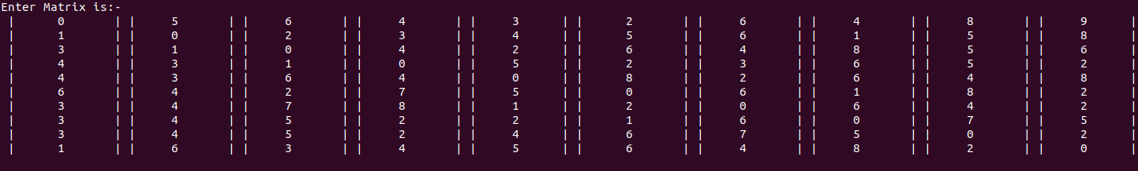
Output/ Result

Slide 11
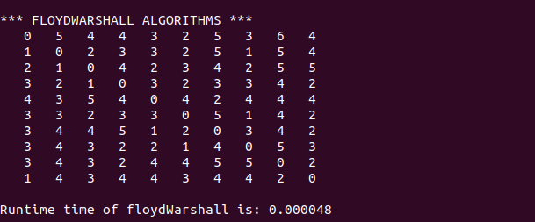

Slide 12
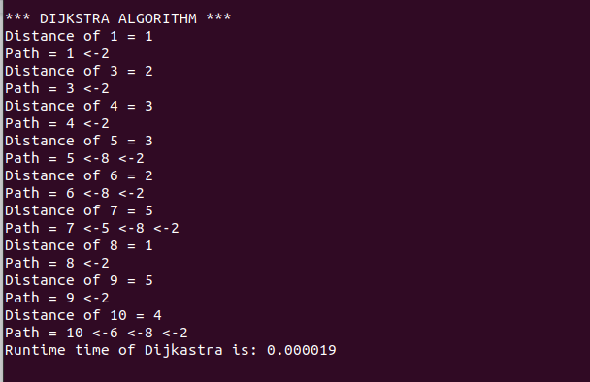

Slide 13
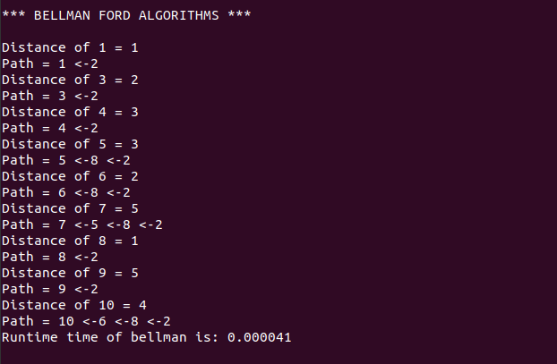

Slide 14
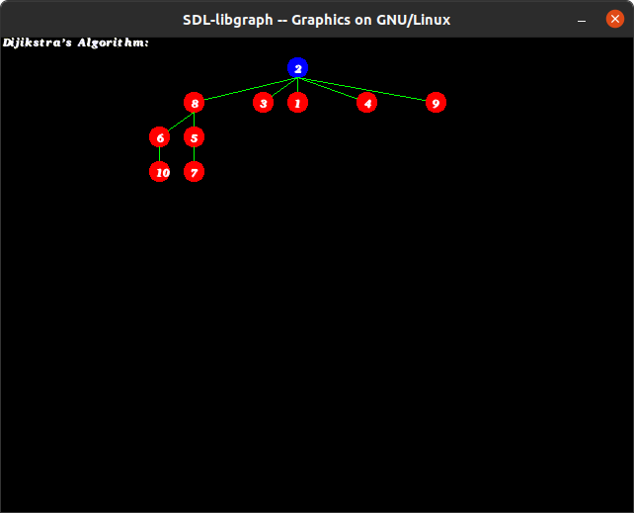
All these comes Step-by-Step

Slide 15
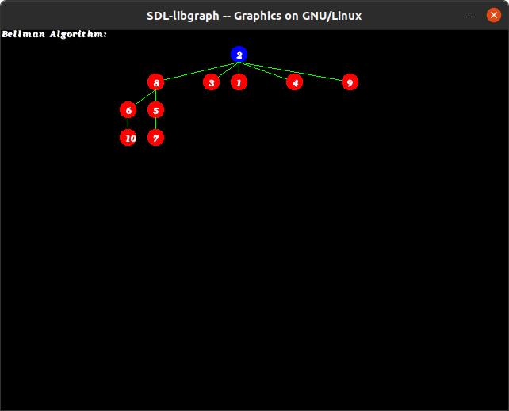
All these comes Step-by-Step

Slide 16
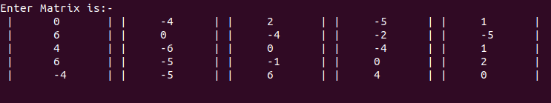
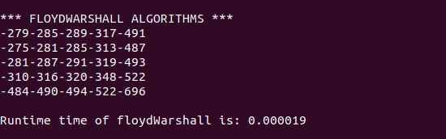

Slide 17
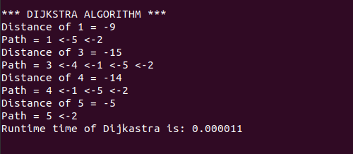
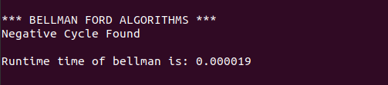

Slide 18
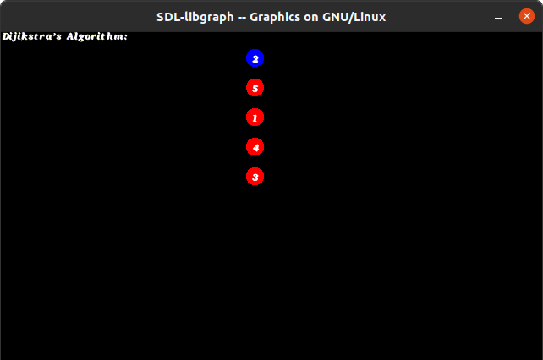
All these comes Step-by-Step

Slide 19
